Slide 1
CS777 Term Project Beer Recommender
Tyson Brown

Slide 2
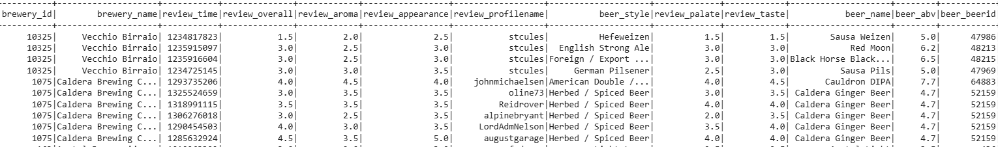
Introduction
This project utilizes a dataset consisting of approx. 1.5 million beer reviews based upon 5 subjective criteria: overall review, aroma, appearance, palate and taste.
The goal of this project is to develop a beer recommender based upon these assessments to be able to provide users with similar beers.
Two different approaches will be tested: Kmeans clustering and ALS.

Slide 3
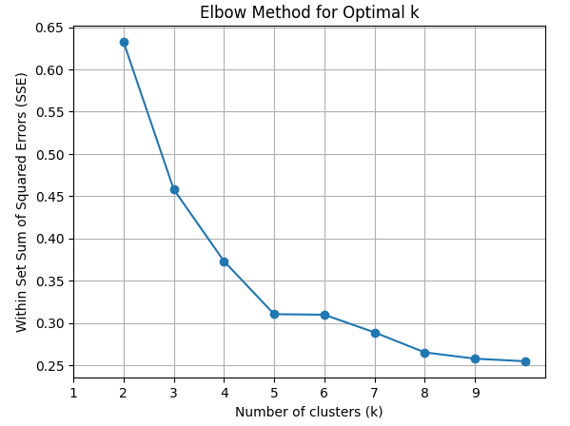
Kmeans Clustering
First step was to vectorize the review scores into features.
Then the optimum value of k needed to be determined using the “elbow method”. Within Set Sum of Squared Error was used to select the best value for k.
A value of 5 was chosen.
Cluster perdictions were then computed.

Slide 4
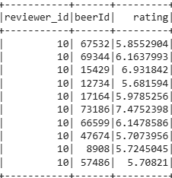
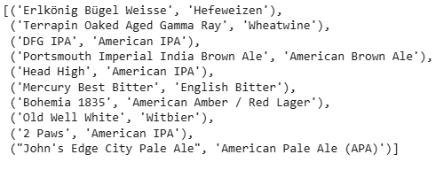
Alternating Least Squares
Als used in collaborative filtering of the beer dataset to develop recommendations based upon historical reviews of users.
Dataset had to be modified slightly to create an index of reviewer ids.
Only the overall review score was used to develop the model.
An 80/20 train test split was used and the test predictions were evaluated using root mean squared error.
Ten recommendations for all users were then generated and entering a reviewer’s id the recommendations are obtained.

Slide 5
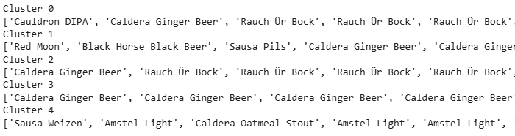
Discussion
The inconsistency in reviews for the Kmeans clustering model caused beers to be assigned to multiple clusters making recommendations unreliable.
In the below results it can be seen that Caldera Ginger Beer is found in clusters 1-3.
It seems like this type of recommender system would only be useful in situations where items can only be in one cluster.
The limitations of ALS discussed in lecture also hold true for this implementation. Users may not have reviewed every beer. Beers with a higher overall rating may be recommended more.

Slide 6
Conclusion
This relatively simple implementation of a recommender system exposes the complexities of such models.
Clustering for this dataset may not be appropriate as items are grouped based upon subjective reviews resulting in assignment to multiple clusters.
The ALS model worked as intended but also has its own limitations.

